Slide 1
AIDA SALES MODEL
Presented by You Exec

Slide 2
Benefits of Using AIDA
Gain greater perspective on current customer acquisition strategies
Effectively apportion time and budget to yield greater returns
Evaluate Customer Acquisition Methods
Time Management and Budgeting
Prioritization of Marketing Efforts
Persuade Prospects to Make a Purchase
Draft interpretation of marketing efforts and prioritize them accordingly
Improve communications and entice prospects to complete a purchase

Slide 3
AIDA Funnel Diagram
Involvement
Promotion
A
I
D
A
Loyalty
Action
As soon as the desire to buy is aroused, this must be pushed into an action, that is, the purchase.
Desire
Interest
Persuade the customers that they desire the product/service and that it will satisfy their needs
Attention
The highlight of the product communication encourages consumer to find out how the product can benefits them.
The product must attract the consumer's attention via advertising materials, typically an “eyecatcher”.

Slide 4
Examples of AIDA Sales Promotion
Attention
Desire
Articles
Advertisement
Paid Search
Landing Pages
Webinars/ Podcasts
White Papers
E-books
Brochures
Microsites
A
I
Interest
Action
D
Web Content
Newsletters
Social Media/Blogs
Email Campaigns
Case Studies
Testimonials
Data Sheets
E-Learning
A

Slide 5
Current Reach
Attention
80%
Interest
Sales Goal
70K
40%
Desire
20%
Current Sales
Action
20K
10%

Slide 6

Current Reach by Location
North America
Africa
Australia
A
I
D
A
A
I
D
A
A
I
D
A
South America
A
I
D
A
Asia
A
I
D
A

Slide 7

Current Reach by Product
Attention
Interest
Desire
Action
Product A
30,000
12,000
1,000
98
Product B
25,000
8,000
460
20
Product C
78,000
44,000
2,700
150
Product D
89,000
58,000
1,500
113
7

Slide 8
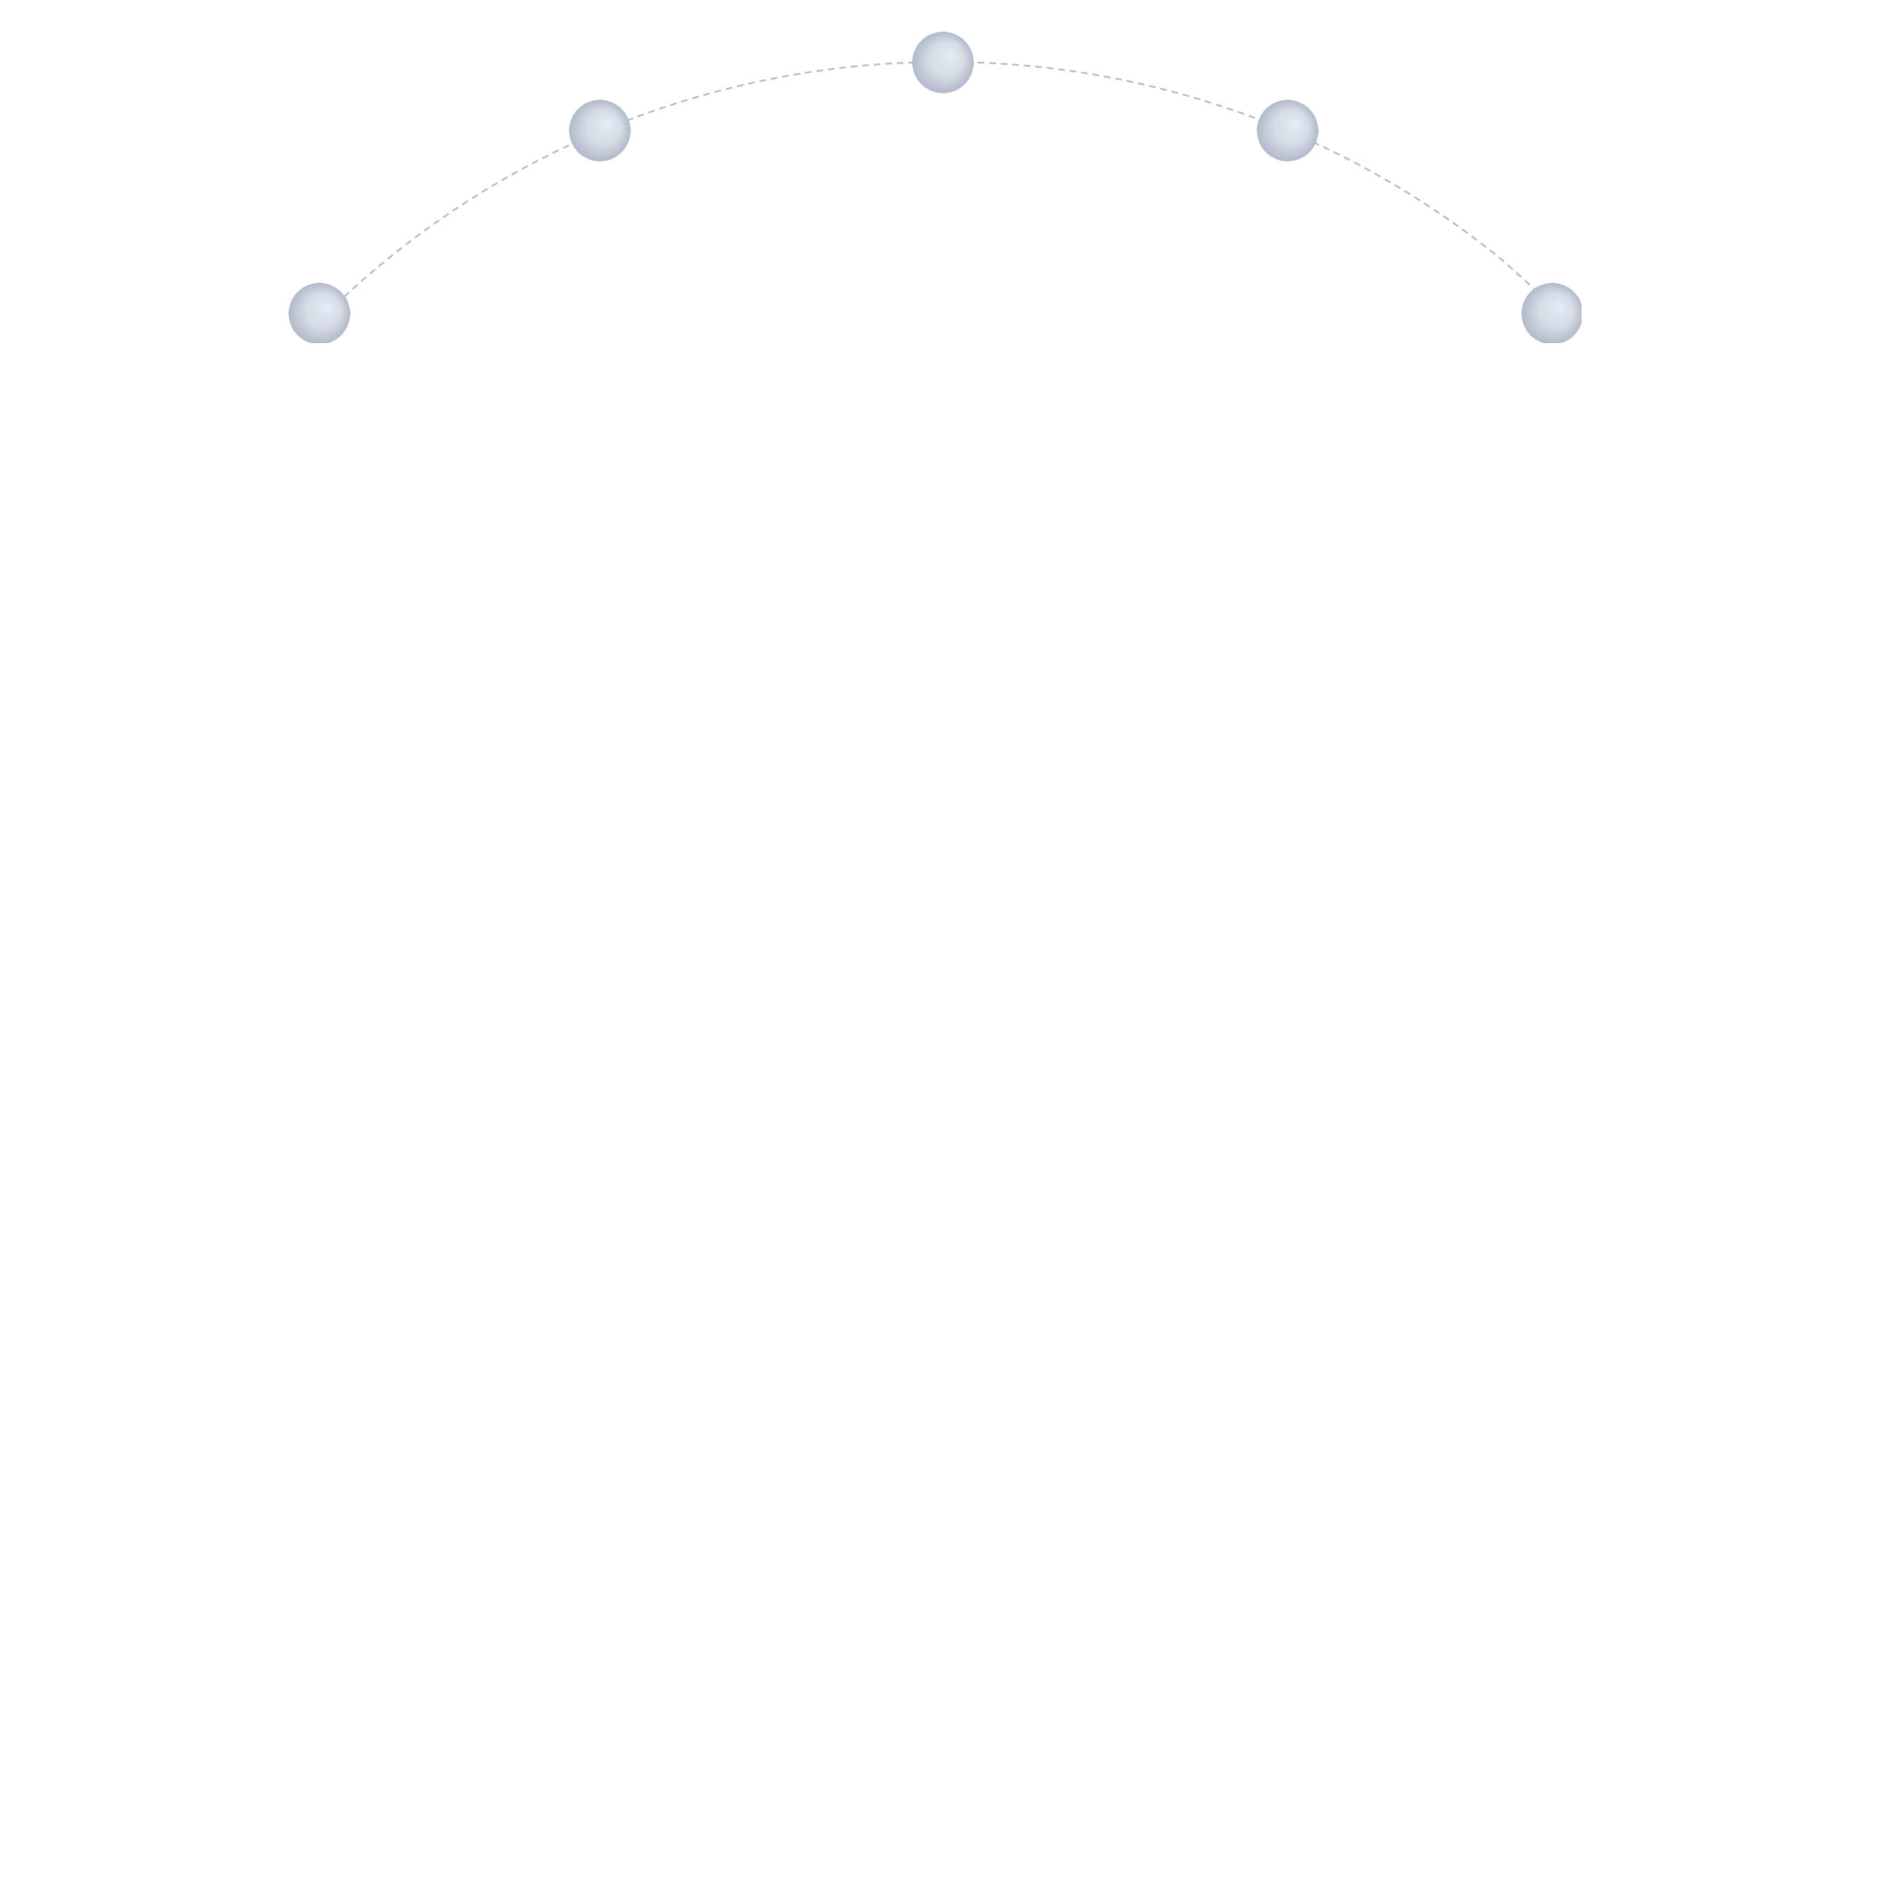
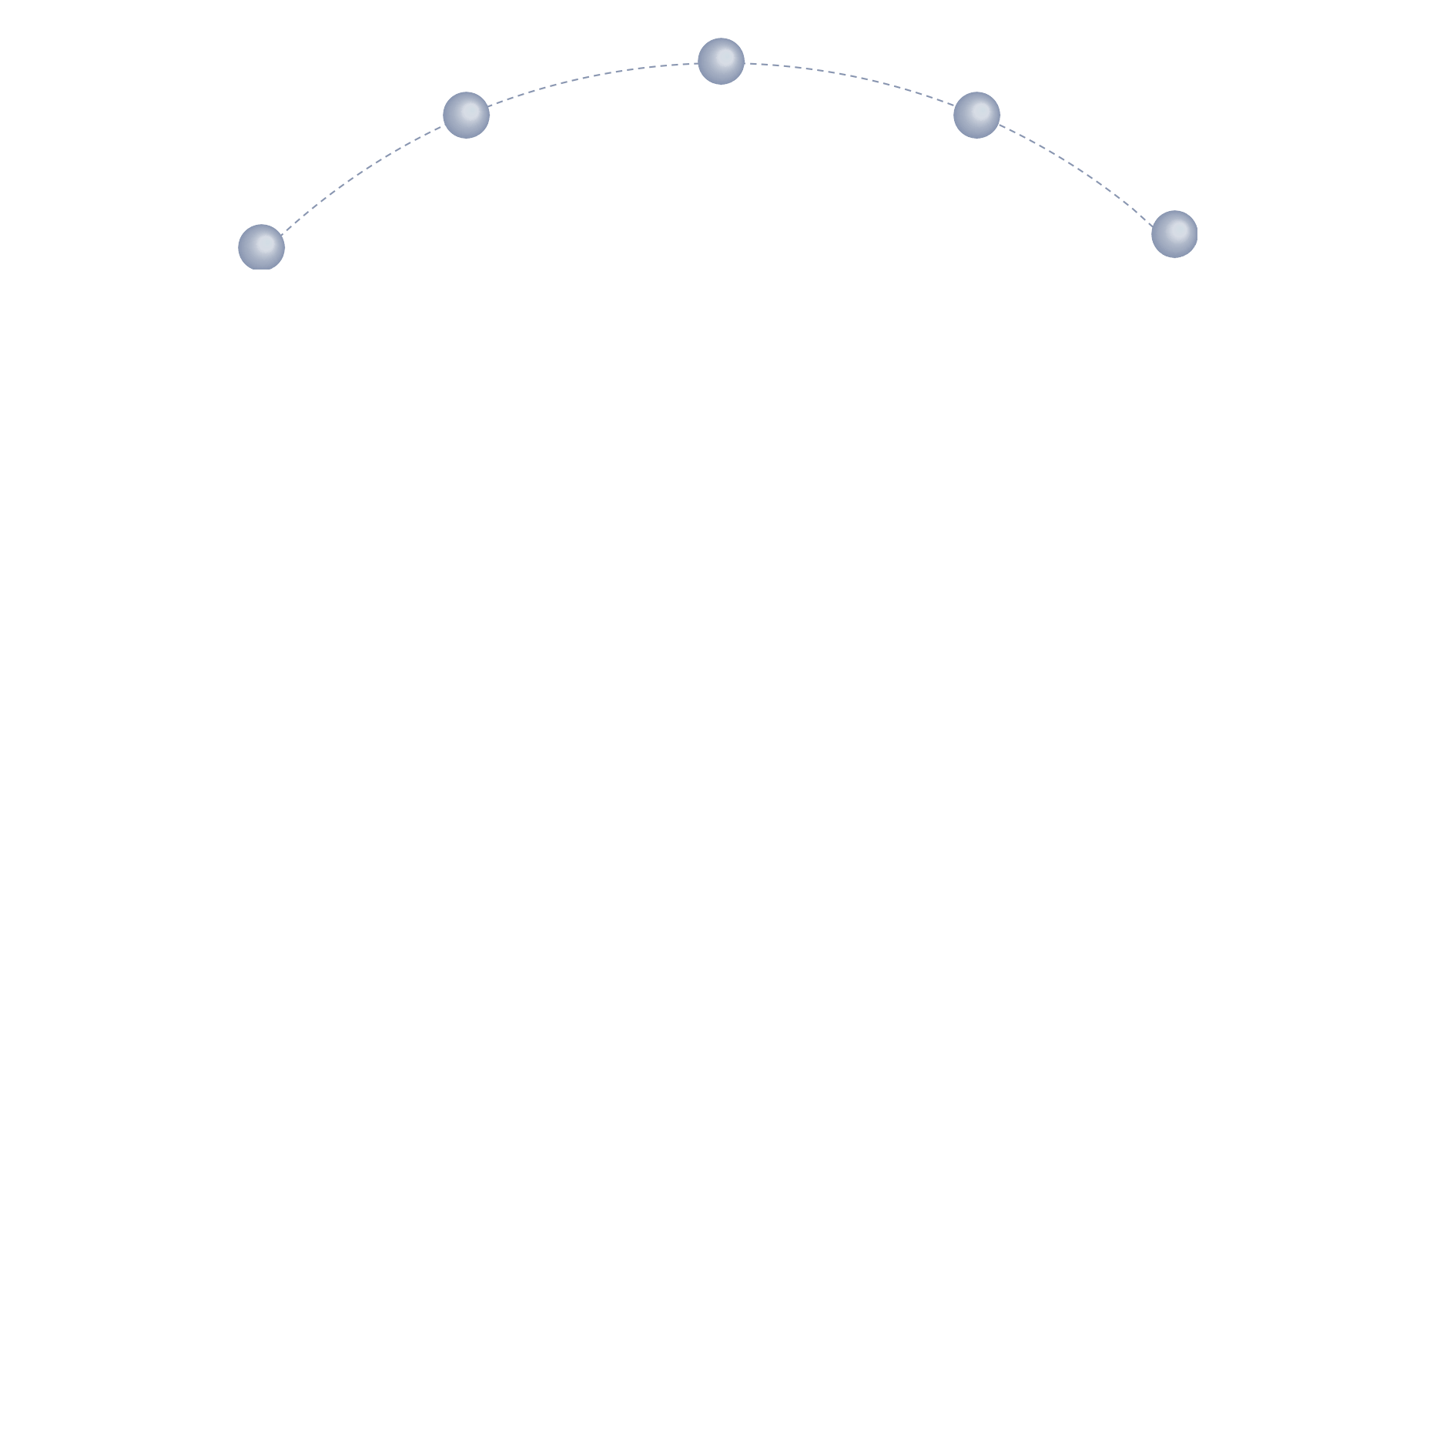
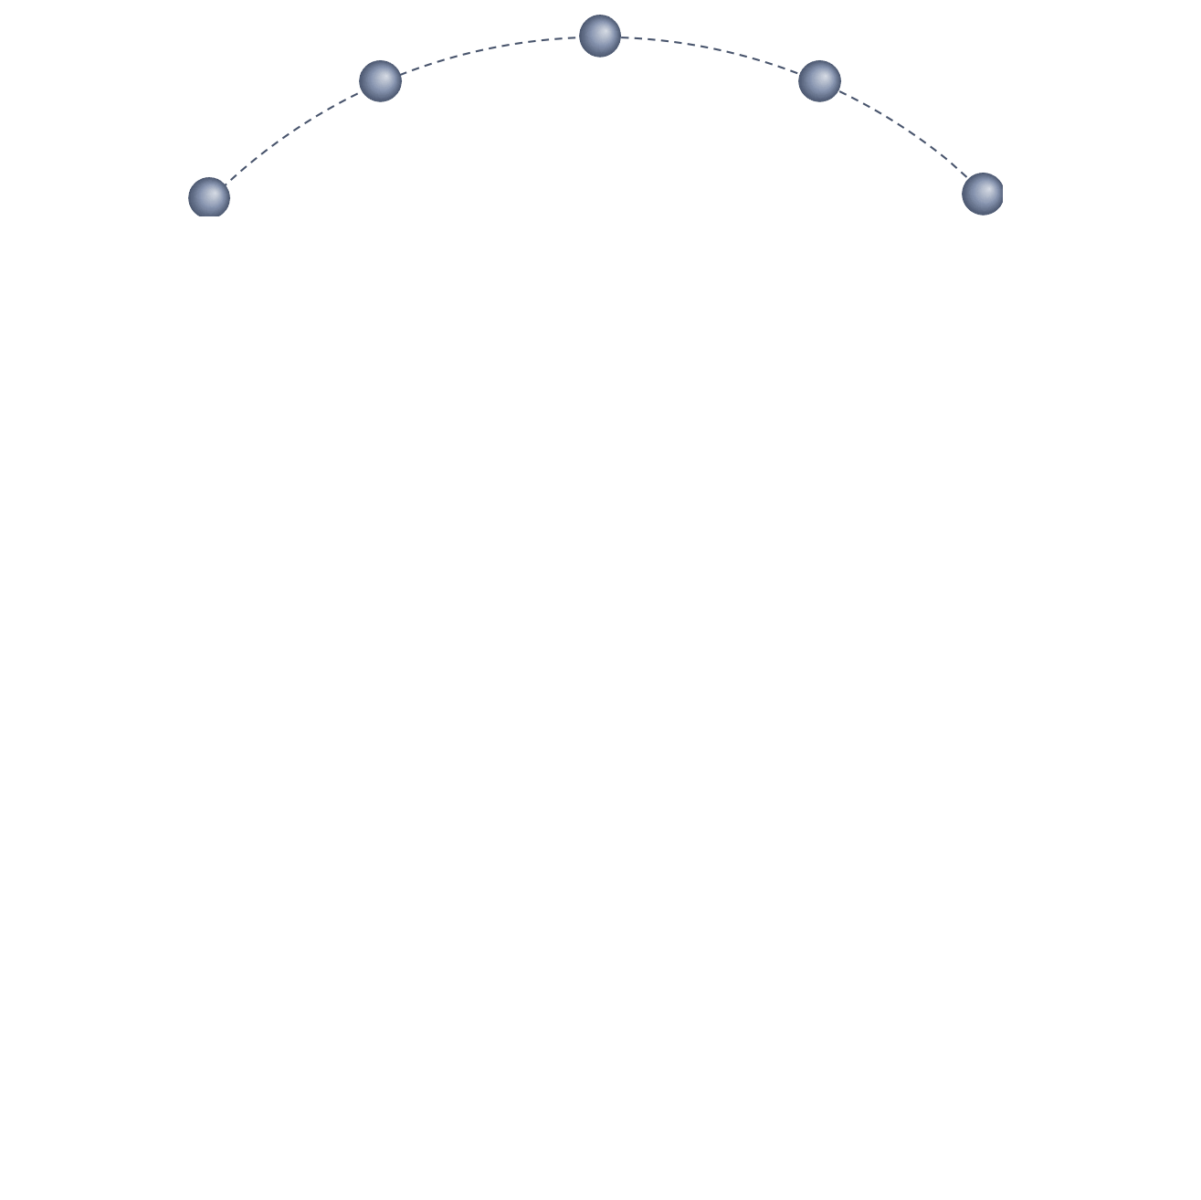
Marketing Strategies for Desire Creation
- Test free trial model
- Periodic giveaways
- New podcast
- Periodic webinars
- Press release awards won
- Work with industry authority
- Credible sponsorship
- Guest blog on authority website
- Test freemium model
- Free add-on product
- Re-write website headlines
- Imply others already use us
- Deal of the Day
- This Month Only
- Limited Time Offer
- Only # Left
Reciprocity
Authority
Loss
Aversion
- It saves to switch to us
- Differentiating strengths
- Offer additional services
Scarcity
Status
Quo Bias

Slide 9
Marketing Cost
Marketing Strategy
Quarter 1
Quarter 2
Quarter 3
Quarter 4
Hack social roof | 600 | 600 | 600 | 600
Create better guest content | 2,000 | 2,000 | 2,000 | 2,000
More segmented ads on social networks | 6,000 | 6,000 | 6,000 | 6,000
Improve copy and brand voice | 400 | 400 | 400 | 400
Subtotal for Attention Generation | 9,000 | 9,000 | 9,000 | 9,000
Plan integrated marketing and content creation strategies | 6,000 | 6,000 | 6,000 | 6,000
Validate buyer personas | 3,000 | 3,000 | 3,000 | 3,000
Identify new audience interests | 2,000 | 2,000 | 2,000 | 2,000
Subtotal for Interest Generation | 11,000 | 11,000 | 11,000 | 11,000
Run Deal of the Day campaigns | 5,000 | 5,000 | 5,000 | 5,000
Find established industry authorities to partner with | 8,000 | 8,000 | 8,000 | 8,000
Host free webinars with our consultants | 7,000 | 7,000 | 7,000 | 7,000
Promote our new add-on services and cost-saving benefits | 10,000 | 10,000 | 10,000 | 10,000
Subtotal for Desire Generation | 30,000 | 30,000 | 30,000 | 30,000
Test new Call-to-Action copy | 1,000 | 1,000 | 1,000 | 1,000
Redesign and/or reposition CTA buttons | 800 | 800 | 800 | 800
Test new platforms for CTA placements | 3,000 | 3,000 | 3,000 | 3,000
Subtotal for Action Generation | 4,800 | 4,800 | 4,800 | 4,800
Total Marketing Cost | 54,800 | 54,800 | 54,800 | 54,800
Attention
Interest
Desire
Action

Slide 10
Marketing Strategies Timeline
Case Studies, Data Sheets, Testimonials Published
Microsites, E-books, Brochures
Email Campaigns, Newsletters, Web Content
Social Media Ads: Demographic Targeting
Q4, 2018
Q1, 2019
Q2, 2019
Q3, 2019
Q4, 2019

